Slide 1
Terminal App
DuyNguyenT1A3

Slide 2



overview
Project Management
Flow chart
Features
The process
Demo

Slide 3
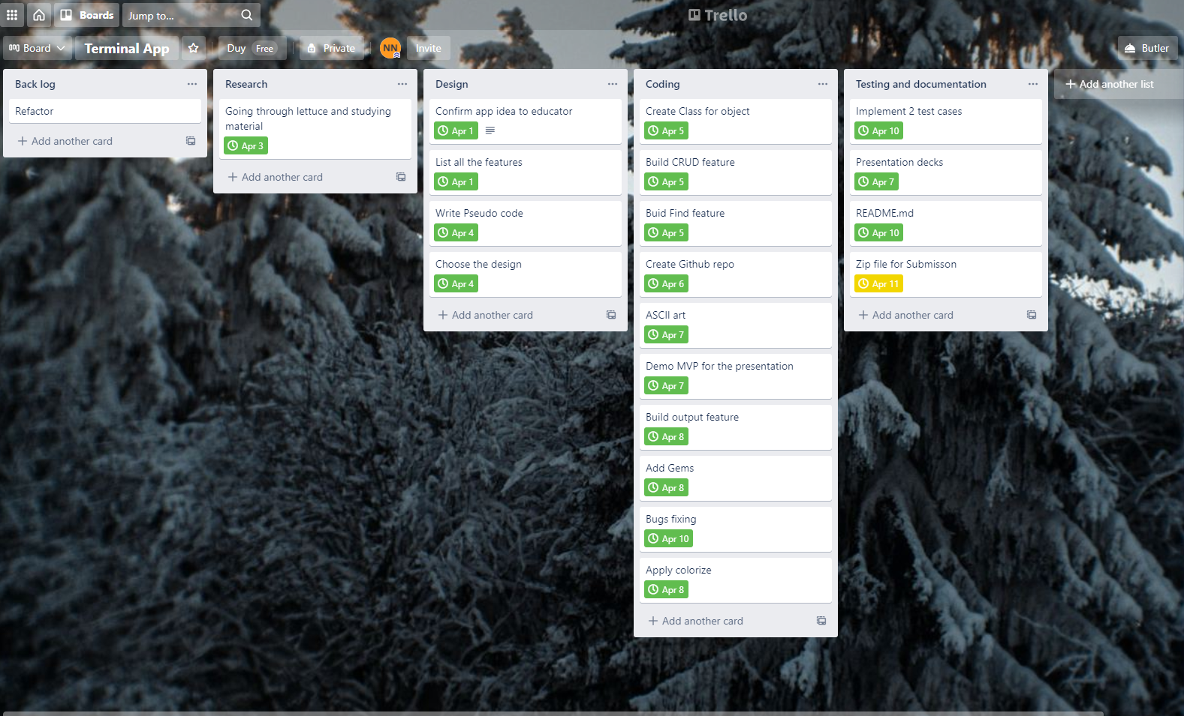
Project management

Slide 4
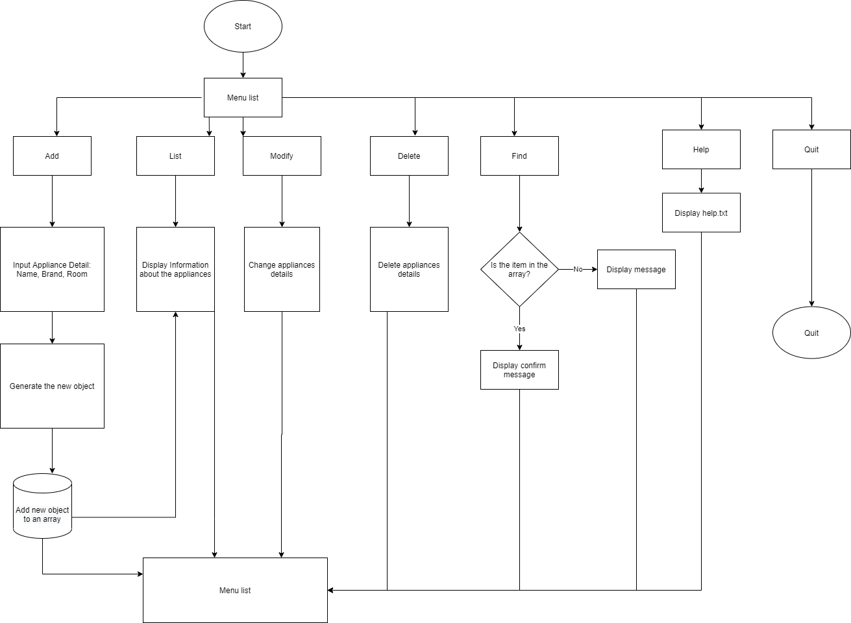
Flow chart

Slide 5

Feature
- CRUD
- FIND Appliances
- Nice output

Slide 6
Development
Challenges
Ethical
Favourite

Slide 7

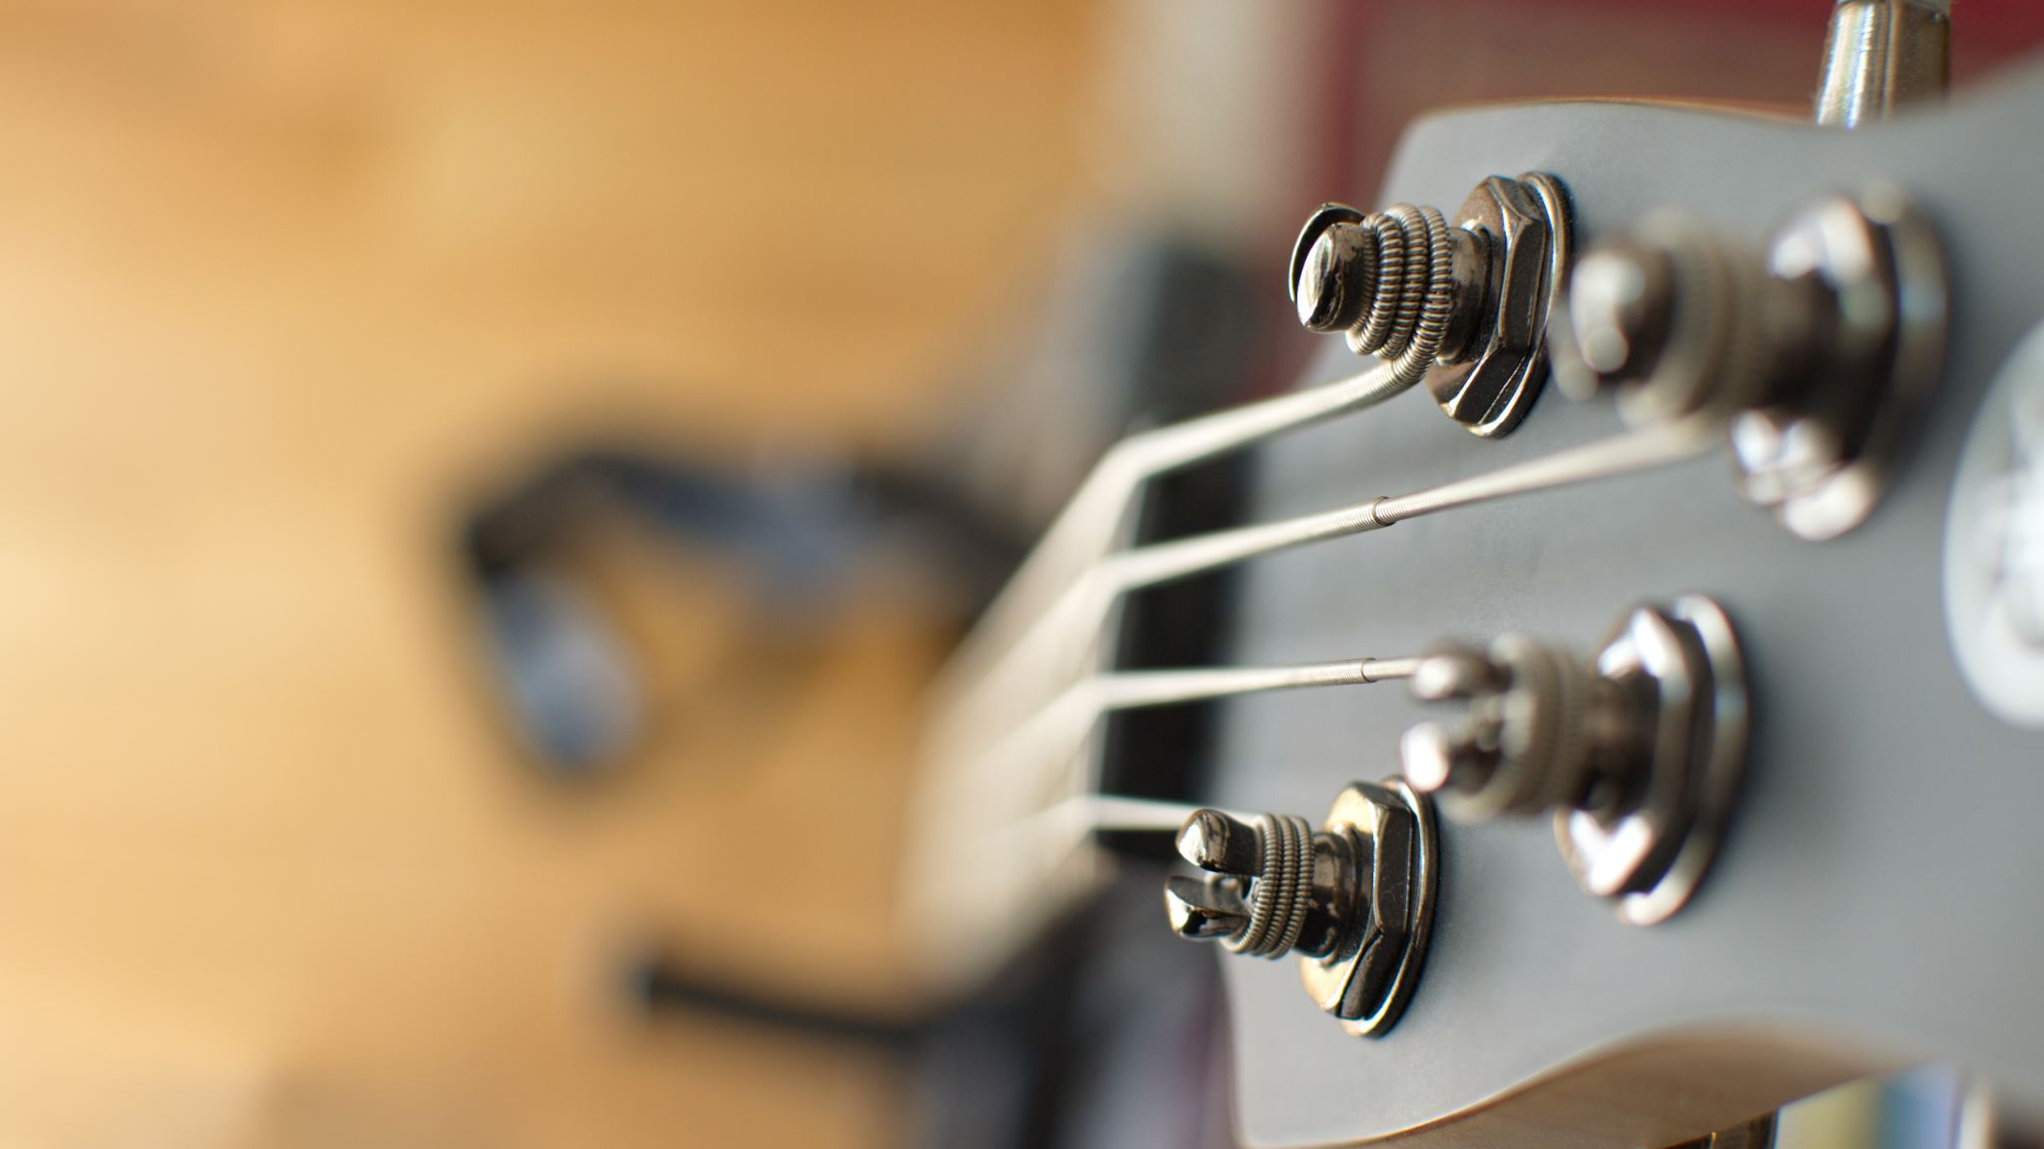

Demo
MVP

